Slide 1
Introduction to PL/SQL
Chapter 4
A Guide to Oracle9i

Slide 2
Lesson A Objectives
Learn the fundamentals of the PL/SQL programming language
Write and execute PL/SQL programs in SQL*Plus
Understand PL/SQL data type conversion functions
Manipulate character strings in PL/SQL programs
Learn how to debug PL/SQL programs
A Guide to Oracle9i

Slide 3
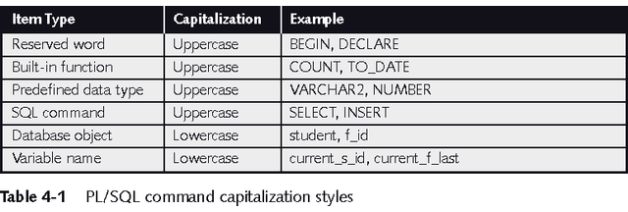
Fundamentals of PL/SQL
Full-featured programming language
An interpreted language
Type in editor, execute in SQL*Plus
A Guide to Oracle9i

Slide 4
Variables and Data Types
Variables
  Used to store numbers, character strings, dates, and other data values
  Avoid using keywords, table names and column names as variable names
  Must be declared with data type before use: variable_name data_type_declaration;
A Guide to Oracle9i

Slide 5
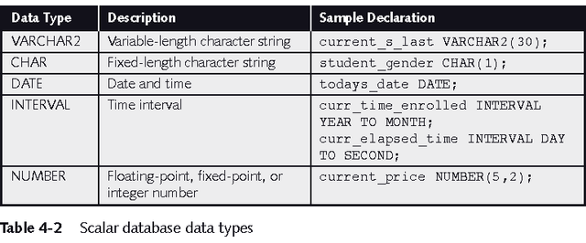
Scalar Data Types
Represent a single value
A Guide to Oracle9i

Slide 6
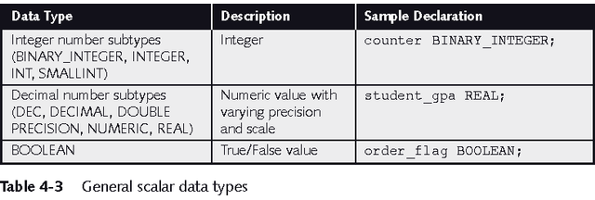
Scalar Data Types
A Guide to Oracle9i

Slide 7
Composite and Reference Variables
Composite variables
  RECORD: contains multiple scalar values, similar to a table record
  TABLE: tabular structure with multiple columns and rows
  VARRAY: variable-sized array
Reference variables
  Directly reference a specific database field or record and assume the data type of the associated field or record
  %TYPE: same data type as a database field
  %ROWTYPE: same data type as a database record
A Guide to Oracle9i

Slide 8
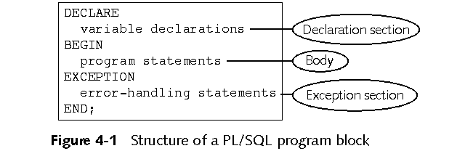
PL/SQL Program Blocks
Comments:
  Not executed by interpreter
  Enclosed between /* and */
  On one line beginning with --
A Guide to Oracle9i

Slide 9
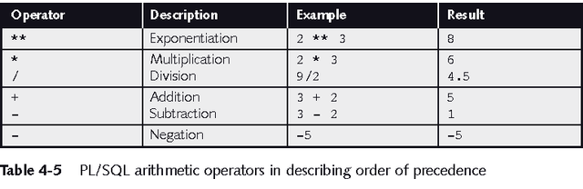
Arithmetic Operators
A Guide to Oracle9i

Slide 10
Assignment Statements
Assigns a value to a variable
variable_name := value;
Value can be a literal:
  current_s_first_name := 'John';
Value can be another variable:
  current_s_first_name := s_first_name;
A Guide to Oracle9i

Slide 11
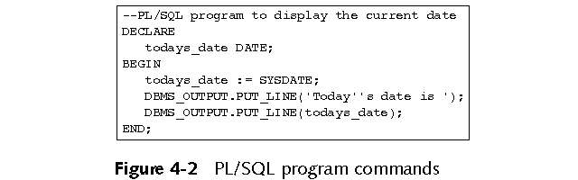
Executing a PL/SQL
Program in SQL*Plus
Create program in text editor
Paste into SQL*Plus window
Press Enter, type / then enter to execute
A Guide to Oracle9i

Slide 12
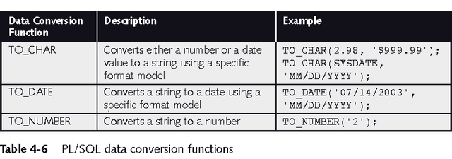
PL/SQL Data Conversion Functions
A Guide to Oracle9i

Slide 13
Manipulating Character
Strings with PL/SQL
To concatenate two strings in PL/SQL, you use the double bar (||) operator:
  new_string := string1 || string2;
To remove blank leading spaces use the LTRIM function:
  string := LTRIM(string_variable_name);
To remove blank trailing spaces use the RTRIM function:
  string := RTRIM(string_variable_name);
To find the number of characters in a character string use the LENGTH function:
  string_length := LENGTH(string_variable_name);
A Guide to Oracle9i

Slide 14
Manipulating Character
Strings with PL/SQL
To change case, use UPPER, LOWER, INITCAP
INSTR function searches a string for a specific substring:
  start_position := INSTR(original_string, substring);
SUBSTR function extracts a specific number of characters from a character string, starting at a given point:
  extracted_string := SUBSTR(string_variable, starting_point, number_of_characters);
A Guide to Oracle9i

Slide 15
Debugging PL/SQL Programs
Syntax error:
  Command does not follow the guidelines of the programming language
  Generates compiler or interpreter error messages
Logic error:
  Program runs but results in an incorrect result
  Caused by mistake in program
A Guide to Oracle9i

Slide 16
Finding and Fixing Syntax Errors
Interpreter flags the line number and character location of syntax errors
If error message appears and the flagged line appears correct, the error usually occurs on program lines preceding the flagged line
Comment out program lines to look for hidden errors
One error (such as missing semicolon) may cause more – fix one error at a time
A Guide to Oracle9i

Slide 17
Finding and Fixing Logic Errors
Locate logic errors by viewing variable values during program execution
There is no SQL*Plus debugger
Use DBMS_OUTPUT statements to print variable values
A Guide to Oracle9i

Slide 18
Lesson B Objectives
Create PL/SQL decision control structures
Use SQL queries in PL/SQL programs
Create loops in PL/SQL programs
Create PL/SQL tables and tables of records
Use cursors to retrieve database data into PL/SQL programs
Use the exception section to handle errors in PL/SQL programs
A Guide to Oracle9i

Slide 19
PL/SQL Decision Control Structures
Use IF/THEN structure to execute code if condition is true
  IF condition THEN
  commands that execute if condition is TRUE;
  END IF;
If condition evaluates to NULL it is considered false
Use IF/THEN/ELSE to execute code if condition is true or false
  IF condition THEN
  commands that execute if condition is TRUE;
  ELSE
  commands that execute if condition is FALSE;
  END IF;
Can be nested – be sure to end nested statements
A Guide to Oracle9i

Slide 20
PL/SQL Decision Control Structures
Use IF/ELSIF to evaluate many conditions:
  IF condition1 THEN
commands that execute if condition1 is TRUE;
ELSIF condition2 THEN
commands that execute if condition2 is TRUE;
ELSIF condition3 THEN
commands that execute if condition3 is TRUE;
...
ELSE
commands that execute if none of the
conditions are TRUE;
END IF;
A Guide to Oracle9i

Slide 21
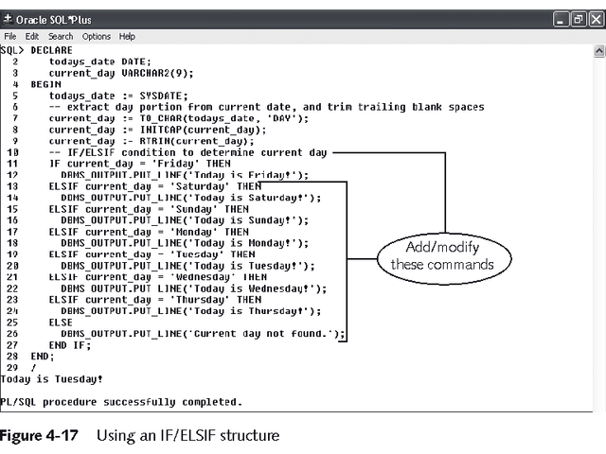
IF/ELSIF Example
A Guide to Oracle9i

Slide 22
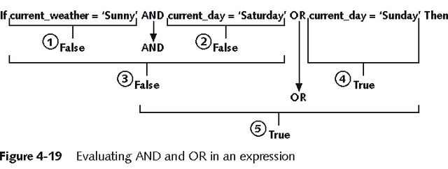
Complex Conditions
Created with logical operators AND, OR and NOT
AND is evaluated before OR
Use () to set precedence
A Guide to Oracle9i

Slide 23
Using SQL Queries in PL/SQL Programs
Action queries can be used as in SQL*Plus
May use variables in action queries
DDL commands may not be used in PL/SQL
A Guide to Oracle9i

Slide 24
Loops
Program structure that executes a series of program statements, and periodically evaluates an exit condition to determine if the loop should repeat or exit
Pretest loop: evaluates the exit condition before any program commands execute
Posttest loop: executes one or more program commands before the loop evaluates the exit condition for the first time
PL/SQL has 5 loop structures
A Guide to Oracle9i

Slide 25
The LOOP...EXIT Loop
  LOOP
  [program statements]
  IF condition THEN
  EXIT;
  END IF;
  [additional program statements]
  END LOOP
A Guide to Oracle9i

Slide 26
The LOOP...EXIT WHEN Loop
  LOOP
  program statements
  EXIT WHEN condition;
  END LOOP;
A Guide to Oracle9i

Slide 27
The WHILE...LOOP
  WHILE condition LOOP
  program statements
  END LOOP;
A Guide to Oracle9i

Slide 28
The Numeric FOR Loop
  FOR counter_variable IN start_value .. end_value
  LOOP
  program statements
  END LOOP;
A Guide to Oracle9i

Slide 29
LOOPING STRUCTURE
Looping means iterations.
A loop repeats a statement or a series of statements a specific number of times as defined by the programmer.
You would use a loop to repeat a series of statements many times rather than typing the same statements many times.
There are three types of looping statements available in PL/SQL:
  Basic loop
  WHILE loop
  FOR loop
Each loop has different syntax, and their working is a little different from each other.

Slide 30
LOOPING STRUCTURE
Basic loop
  A basic loop is a loop that is performed repeatedly.
  When the bottom of the loop is reached, control shifts back to the top of the loop.
  The only way to terminate a basic loop is by adding an EXIT statement inside the loop.
        LOOP
        Looping statement1;
        Looping statement2;
        . . .
        Looping statementN;
        EXIT [WHEN condition];
        END LOOP;
  The condition is not checked at the top of the loop, but it is checked inside the body of the loop.
  The basic loop is performed at least once as the condition is tested after entering body of the loop.

Slide 31
LOOPING STRUCTURE
Basic loop (cont.)
  There are three necessary statements in a counter-controlled loop.
  The counter must be initialized, the value of the counter must change within the loop (increment or decrement), and a proper condition must exist in the loop.
  If value of the counter is not changed inside the loop, it will result in an infinite loop.
  The initial value, the increment/decrement, and the condition control the total number of loop executions.

Slide 32
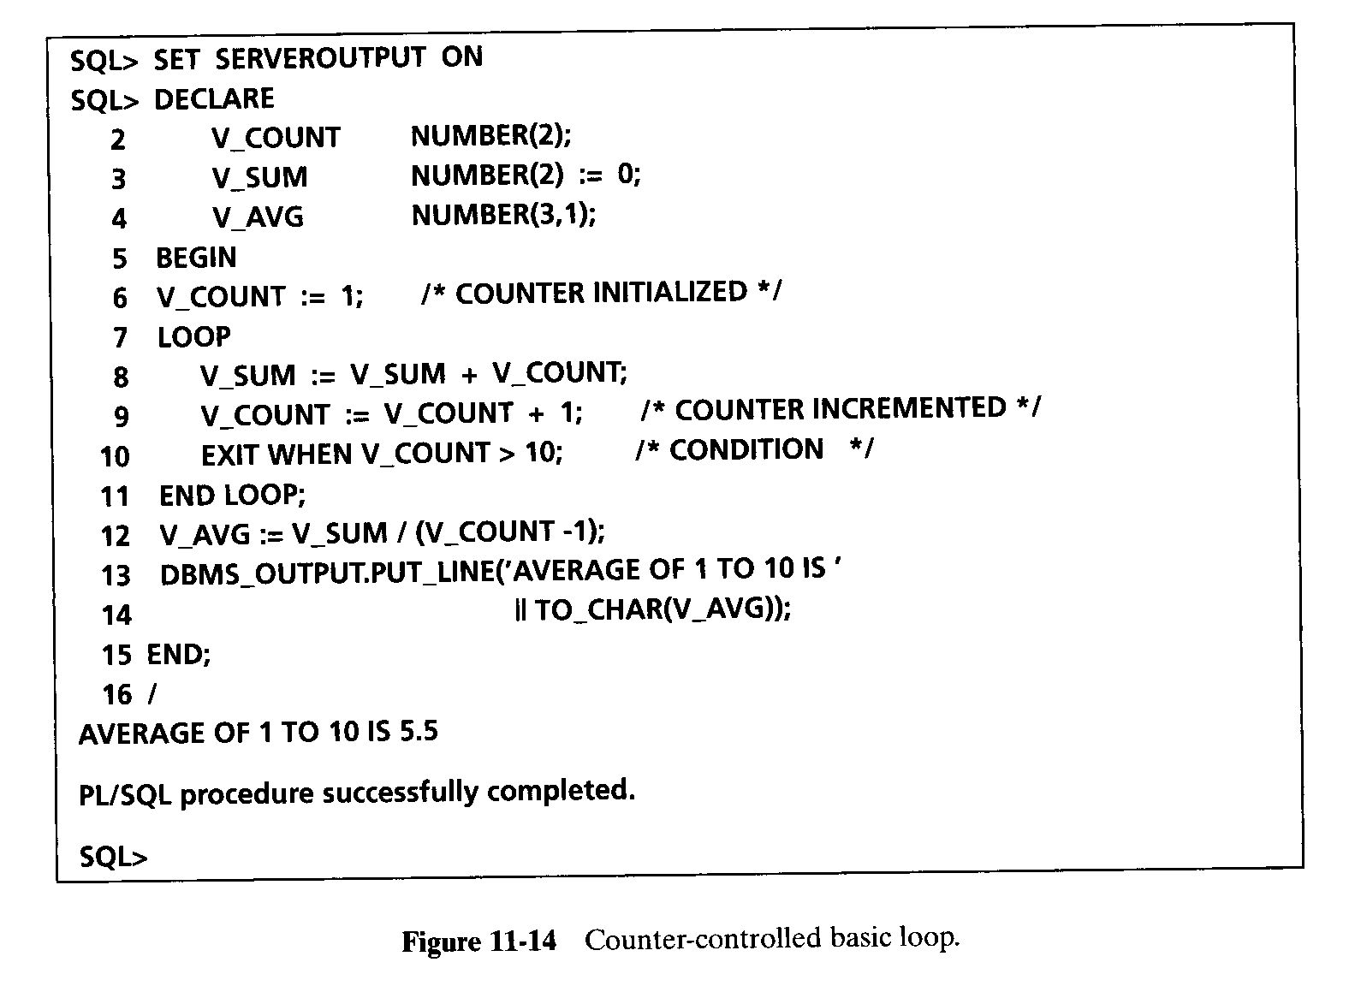
LOOPING STRUCTURE

Slide 33
LOOPING STRUCTURE
WHILE loop
  The WHILE loop is an alternative to the basic loop.
  The WHILE loop is performed as long as the condition is true.
  It terminates when the condition becomes false.
  If the condition is false at the beginning of the loop, the loop is not performed at all.
  The WHILE loop does not need an EXIT statement to terminate.
        WHILE condition LOOP
        Looping statement 1;
        Looping statement 2;
        . . .
        Looping statement n;
        END LOOP;

Slide 34
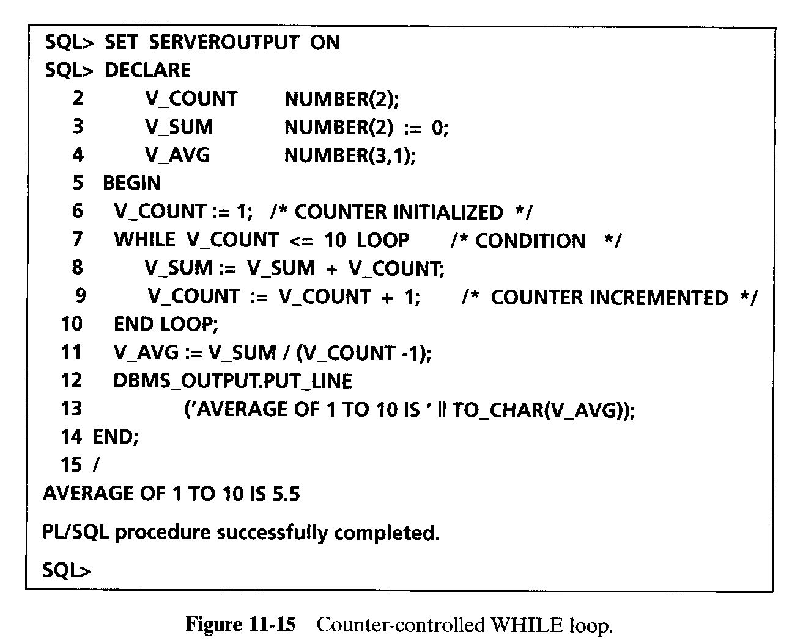
LOOPING STRUCTURE

Slide 35
LOOPING STRUCTURE
FOR loop
  The FOR loop is the simplest loop you can write.
  Unlike the other two loops, you do not have to initialize, test, and increment/decrement the loop control variable separately. You do it in the loop’s header.
  There is no need to use an EXIT statement, and the counter need not be declared.
  The counter used in the loop is implicitly declared as an integer, and it is destroyed on the loop’s termination.
  Counter may not be used within the loop body in an assignment statement as a target variable.
        FOR counter IN [REVERSE] lower..upper LOOP
        Looping statement1
        Looping statement2
        . . .
        Looping statementN
        END LOOP;

Slide 36
LOOPING STRUCTURE
FOR loop (cont.)‏
  The counter varies from the lower value to the upper value, incrementing by 1 with every loop execution.
  The loop can be used with the counter starting at a higher value and decrementing by 1 with every loop execution.
  The keyword REVERSE is used for varying the counter in the reverse order, or from higher to lower value.
  One important point about loop control variable is that it is declared, incremented/decremented and destroyed implicitly, but its value cannot be changed explicitly within the FOR loop’s body.
  It cannot be a target variable in an assignment statement.

Slide 37
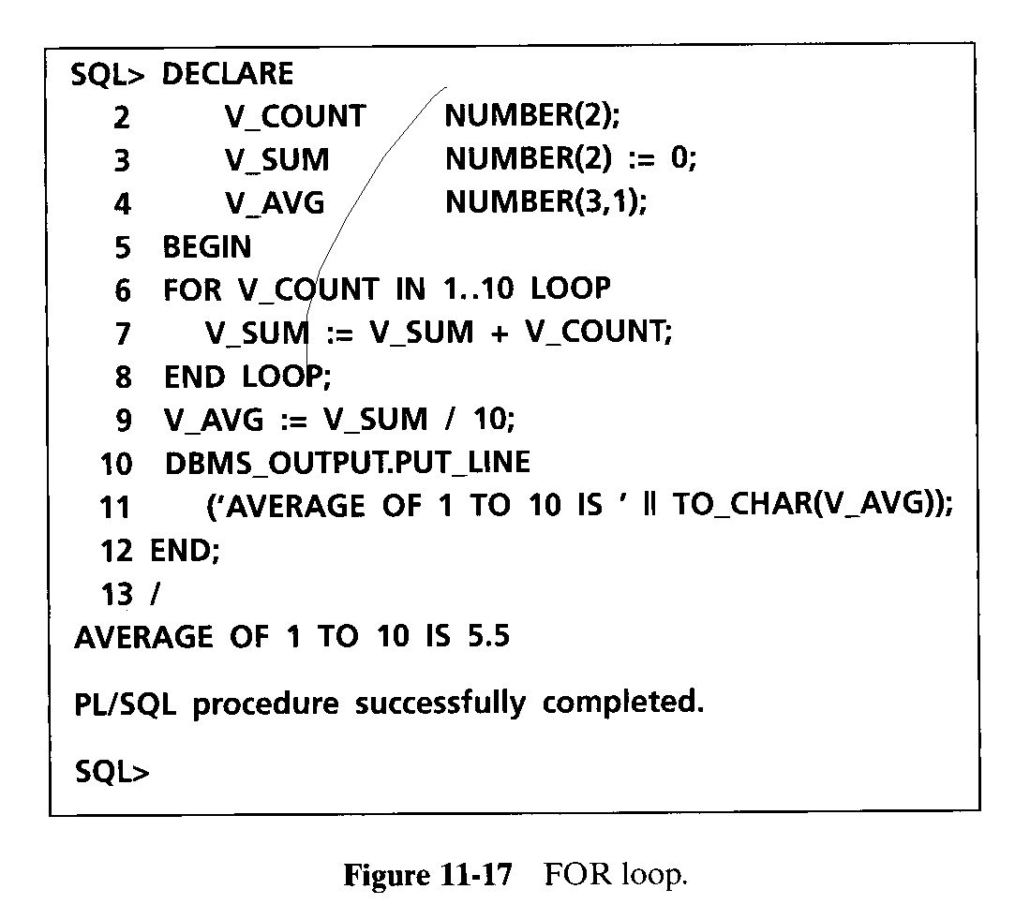
LOOPING STRUCTURE

Slide 38
LOOPING STRUCTURE
Nested loops
  You can use a loop within another loop.
  The nesting of loops can be to many levels.
  When the inner loop ends, it does not automatically end the outer loop enclosing it.
  You can end an outer loop from within the inner loop by labeling each loop and then using the EXIT statement.
  The EXIT WHEN exits the current loop, but EXIT out_loop WHEN exits the outer loop also.
  The loop labels use the same naming rules used for identifiers.
  The loops are labeled before the keyword LOOP on the same line or on a separate line.
  The loop label is enclosed within two pairs of angle brackets (<< and >>).

Slide 39
LOOPING STRUCTURE
<<out_loop>>
LOOP
. . .
EXIT WHEN condition;
<<in_loop>>
LOOP
. . .
EXIT out_loop WHEN condition; /* exits out_loop */
EXIT WHEN condition; /*exits in_loops */
. . .
END LOOP in_loop; /* label optional here */
. . .
END LOOP out_loop; /*label optional here */

Slide 40
NESTED BLOCKS
PL/SQL block may contain another PL/SQL block, or in other words PL/SQL blocks can be nested.
The execution starts with the outer block and continues with the inner block.
The variables declared in the outer block are global to the inner block, and they are accessible in the inner block.
The variables declared in the inner block are not accessible in the outer block.
DECLARE /* Outer block starts here.*/
Var1 NUMBER; /* known to outer and inner*/
BEGIN
. . . /* can use Var1 here */
  DECLARE /*Inner block starts here.*/
Var2 NUMBER; /* known to inner block */
  BEGIN
. . . /* can use Var1 and Var2 here */
  END; /* Inner block ends here.*/
. . . /* can use Var1 here */
END; /* Outer block ends here.*/

Slide 41
Substitution Variables
PLSQL is not a stand alone programming language
It exists only as a tool with in the Oracle programming environment.
It does not have a capabilities to accept input from the user.
SQL*Plus allows a PL/SQL block to receive input information with the help of substitution variables.
Substitution variables cannot be used to output values, because no memory is allocated for them.
SQL*Plus substitutes avariable before the PL/SQL block is sent to the database.
Substitution variables usually prefixed by the ( &) or double ampersand(&&) characters

Slide 42
EXAMPLE
DECLARE
v_student_id NUMBER := &sv_student_id;
v_first_name VARCHAR2(35);
v_last_name VARCHAR2(35);
BEGIN
SELECT first_name, last_name
INTO v_first_name, v_last_name
FROM student
WHERE student_id = v_student_id;
DBMS_OUTPUT.PUT_LINE
('Student name: '||v_first_name||' '||v_last_name);
EXCEPTION
WHEN NO_DATA_FOUND THEN
DBMS_OUTPUT.PUT_LINE('There is no such student');
END;

Slide 43
SQL IN PL/SQL
The PL/SQL statements have control structures for calculations, decision making, and iterations.
You need to use SQL to interface with the Oracle database.
When changes are necessary in the database, SQL can be used to retrieve and change information.
PL/SQL supports all the Data Manipulation Language (DML) statements such as INSERT, UPDATE, and DELETE.
It also supports the Transaction Control Language statements ROLLBACK, COMMIT, and SAVEPOINT.
You can retrieve data using the data retrieval statement SELECT.
A row of data can be used to assign values to variables.
More than one row can be retrieved and processed using cursors.

Slide 44
SQL IN PL/SQL
PL/SQL statements can use single-row functions, but group functions are not available for PL/SQL statements.
SQL statements in PL/SQL block can still utilize those group functions.
PL/SQL does not support Data Definition Language (DDL) statements such as CREATE, ALTER, and DROP.
The Data Control Language (DCL) statements GRANT and REVOKE are not available in PL/SQL either.

Slide 45
SELECT Statement in PL/SQL
The SELECT statement retrieves data from Oracle tables.
The syntax of SELECT is different in PL/SQL because it is used to retrieve values from a row into a list of variables or into a PL/SQL record.
SELECT ColumnNames INTO VariableNames / RecordName
FROM TableName WHERE condition;
  where ColumnNames must contain at least one column and may include arithmetic or string expressions, single-row functions, and group functions.
  VariableNames contains a list of local or host variables to hold values retrieved by the SELECT clause.
  The variables are either declared at SQL*Plus prompt, or declared locally under the DECLARE section.
  RecordName is a PL/SQL record.

Slide 46
SELECT Statement in PL/SQL
  All the features of SELECT in SQL are available with an added mandatory INTO clause.
  The INTO clause must contain one variable for each value retrieved from the table.
  The order and data type of columns and variables must correspond.
  The SELECT…INTO statement must return one and only one row.
  If no rows are returned, the standard exception (error condition) NO_DATA_FOUND occurs.
  If more than one row is retrieved, the TOO_MANY_ROWS exception occurs.
  The SQL statement in PL/SQL ends with a semicolon.
  The INTO clause is mandatory in SELECT statement, when used in a PL/SQL block.

Slide 47
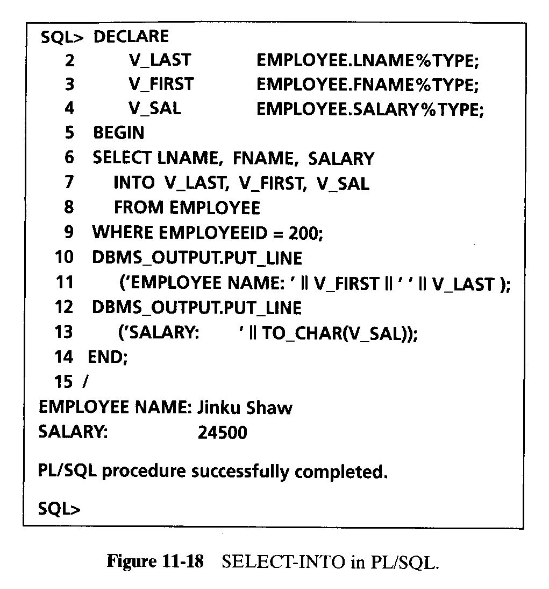
SELECT Statement in PL/SQL

Slide 48
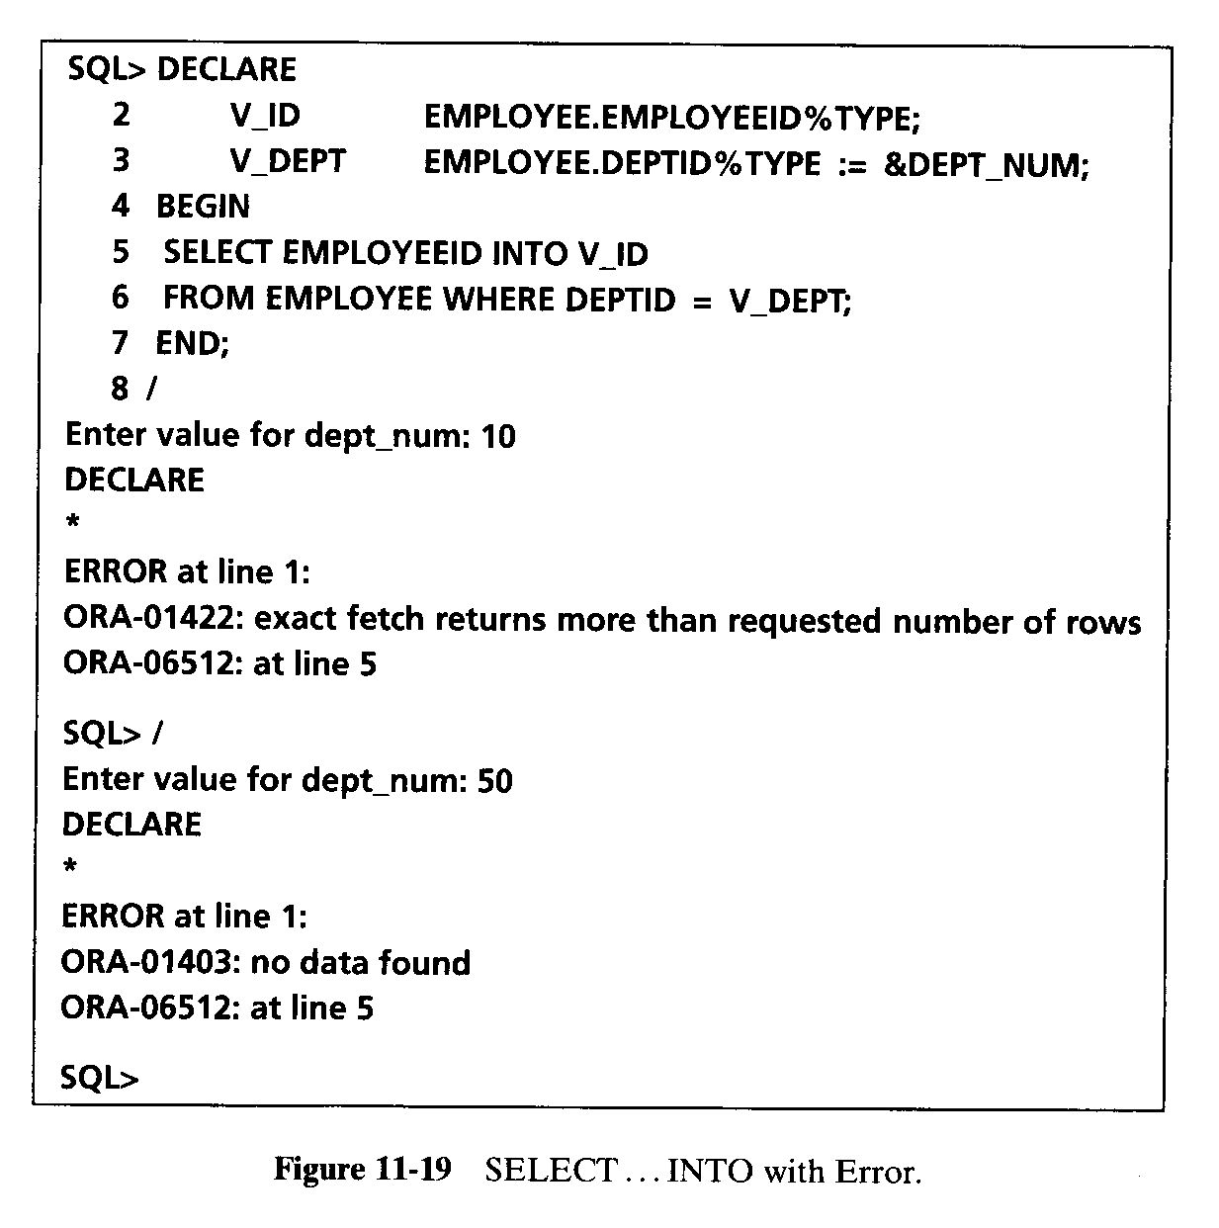
SELECT Statement in PL/SQL

Slide 49
DATA MANIPULATION IN PL/SQL
You can use all DML statements in PL/SQL with the same syntax you used in SQL.
The three DML statements to manipulate data are
  INSERT Statement
    The INSERT statement to add a new row in a table.
  DELETE Statement
    The DELETE statement to remove a row or rows.
  UPDATE Statement
    The UPDATE statement to change values in a row or rows.

Slide 50
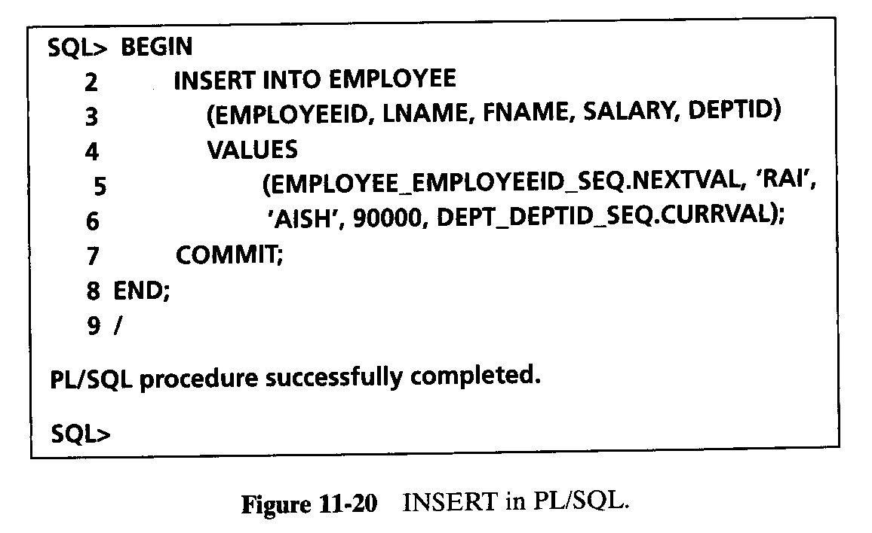
DATA MANIPULATION IN PL/SQL
ORACLE sequence is an Oracle database object that can be used to generate unique numbers.
Use sequences to automatically generate primary key values
Once the sequence has been created, you can access its values in SQL statements with these pseudo columns
CURRVAL :returns the current value of the sequence
NEXTVAL: increments the sequence and returns the new value

Slide 51
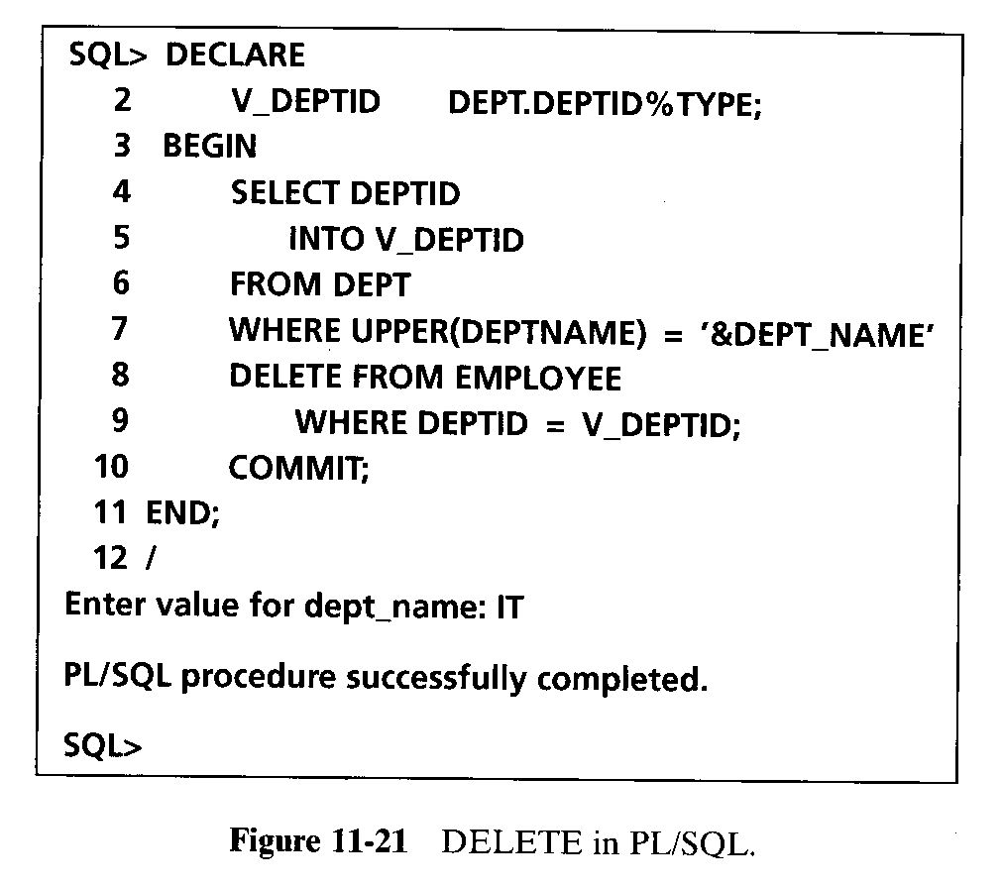
DATA MANIPULATION IN PL/SQL

Slide 52
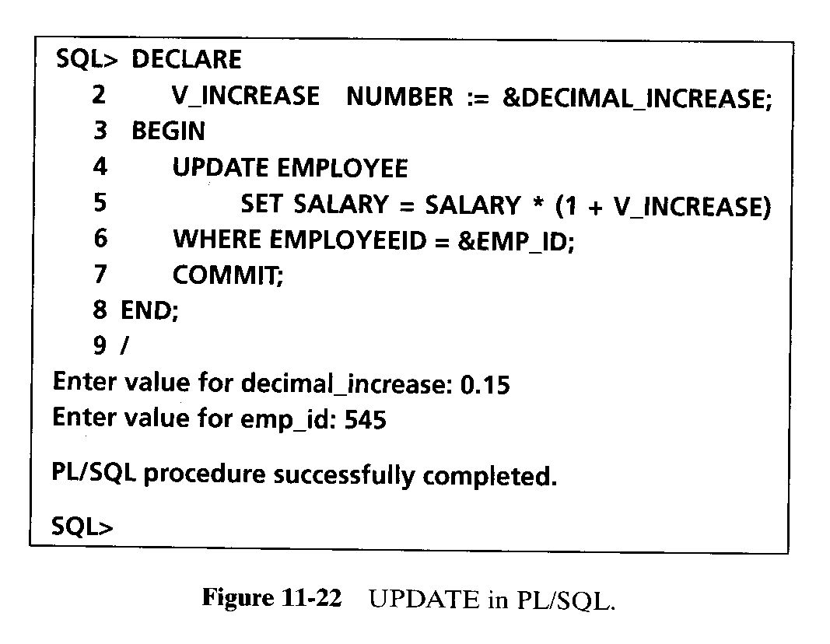
DATA MANIPULATION IN PL/SQL

Slide 53
Practice Exercises
Write a PL/SQL block to find out if a year is a leap year.
  A leap year is divisible by 4, but not divisible by 100, or it is divisible by 400.
  For example, 2000 and 2004 are leap years, but 1900 and 2001 are not leap years. (Hint: The function MOD (n, d) divides n by d and returns the integer remainder from the operation)‏
Write a PL/SQL block to print all odd numbers between 1 and 10 using a basic loop.
Using a FOR loop, print the values 10 to 1 in reverse order.
Create a table called ITEM with one column ItemNum with NUMBER type.
  Write a PL/SQL program to insert values of 1 to 5 for ItemNum.
Input a number with a substitution variable and then print its multiplication table using a WHILE loop.

Slide 54
Practice Exercises
Input a month number between 1 and 12 and a 4-digit year, and print number of days in that month.
  For February (month = 2), check for leap year to display number of days equal to 28 or 29.
Use a PL/SQL block to delete item number 4 from the ITEM table created in question 4.
Write a PL/SQL block to ask a user to input a valid employee Id.
  Retrieve employees name, qualification description, salary and commission.
  Print name, qualification and sum of salary and commission.

Slide 55
Manipulating Data Using PL/SQL
Make changes to database tables by using DML commands:
  INSERT
  UPDATE
  DELETE
INSERT
UPDATE
DELETE
Notes:
Manipulating Data Using PL/SQL
You manipulate data in the database by using the DML (data manipulation) commands. You can issue the DML commands INSERT, UPDATE, and DELETE without restriction in PL/SQL. Including COMMIT or ROLLBACK statements in the PL/SQL code releases row locks (and table locks).
The INSERT statement adds new rows of data to the table.
The UPDATE statement modifies existing rows in the table.
The DELETE statement removes unwanted rows from the table.

Slide 56
Updating Data
Increase the salary of all employees in the emp table who are Analysts.
Example
DECLARE
v_sal_increase emp.sal%TYPE := 2000;
BEGIN
UPDATE emp
SET sal = sal + v_sal_increase
WHERE job = 'ANALYST';
END;
Notes:
Updating and Deleting Data
There may be ambiguity in the SET clause of the UPDATE statement because although the identifier on the left of the assignment operator is always a database column, the identifier on the right can be either a database column or a PL/SQL variable.
Remember that the WHERE clause is used to determine which rows are affected. If no rows are modified, no error occurs, unlike the SELECT statement in PL/SQL.
Note: PL/SQL variable assignments always use := and SQL column assignments always use =. Recall that if column names and identifier names are identical in the WHERE clause, the Oracle Server looks to the database first for the name.
Class Management Note
Demo: l18update.sql
Purpose: This example demonstrates using the UPDATE statement in an anonymous block.
Verify the change to the table. Enter SELECT * FROM emp.

Slide 57
Deleting Data
Delete rows that belong to department 10 from the emp table.
Example
DECLARE
v_deptno emp.deptno%TYPE := 10;
BEGIN
DELETE FROM emp
WHERE deptno = v_deptno;
END;
Notes:
Deleting Data
Delete a specified order.
Class Management Note
Demo: l18delete.sql
Purpose: This example demonstrates using the DELETE statement in an anonymous block.
Verify the change to the table. Enter SELECT * FROM emp, where deptno is the department number and 'CLERK' is the job.
DECLARE
v_ordid ord.ordid%TYPE := 605;
BEGIN
DELETE FROM item
WHERE ordid = v_ordid;
END;

Slide 58
Cursors
Pointer to a memory location that the DBMS uses to process a SQL query
Use to retrieve and manipulate database data
A Guide to Oracle9i

Slide 59
SQL Cursor
  A cursor is a private SQL work area.
  There are two types of cursors:
    Implicit cursors
    Explicit cursors
  The Oracle Server uses implicit cursors to parse and execute your SQL statements.
  Explicit cursors are explicitly declared by the programmer.
Notes:
SQL Cursor
Whenever you issue a SQL statement, the Oracle Server opens an area of memory in which the command is parsed and executed. This area is called a cursor.
When the executable part of a block issues a SQL statement, PL/SQL creates an implicit cursor, which has the SQL identifier. PL/SQL manages this cursor automatically. The programmer explicitly declares and names an explicit cursor. There are four attributes available in PL/SQL that can be applied to cursors.
Note: More information about explicit cursors is covered in a subsequent lesson.
For more information, see
PL/SQL User’s Guide and Reference, Release 8, “Interaction with Oracle.”

Slide 60
SQL Cursor Attributes
Using SQL cursor attributes, you can test the outcome of your SQL statements.
SQL%ROWCOUNT Number of rows affected by the most recent SQL statement (an integer value)
SQL%FOUND Boolean attribute that evaluates to TRUE if the most recent SQL statement affects one or more rows
SQL%NOTFOUND Boolean attribute that evaluates to TRUE if the most recent SQL statement does not affect any rows
SQL%ISOPEN Always evaluates to FALSE because PL/SQL closes implicit cursors immediately after they are executed
Notes:
SQL Cursor Attributes
SQL cursor attributes allow you to evaluate what happened when the implicit cursor was last used. You use these attributes in PL/SQL statements such as functions. You cannot use them in SQL statements.
You can use the attributes SQL%ROWCOUNT, SQL%FOUND, SQL%NOTFOUND, and SQL%ISOPEN in the exception section of a block to gather information about the execution of a data manipulation statement. PL/SQL does not consider a DML statement that affects no rows to have failed, unlike the SELECT statement, which returns an exception.
Class Management Note
SQL%ISOPEN is included here for completeness; it is used with explicit cursors.

Slide 61
SQL Cursor Attributes
Delete rows that have the specified order number from the ITEM table. Print the number of rows deleted.
Example
VARIABLE rows_deleted VARCHAR2(30)
DECLARE
v_ordid NUMBER := 605;
BEGIN
DELETE FROM item
WHERE ordid = v_ordid;
:rows_deleted := (SQL%ROWCOUNT ||
' rows deleted.');
END;
/
PRINT rows_deleted

Slide 62
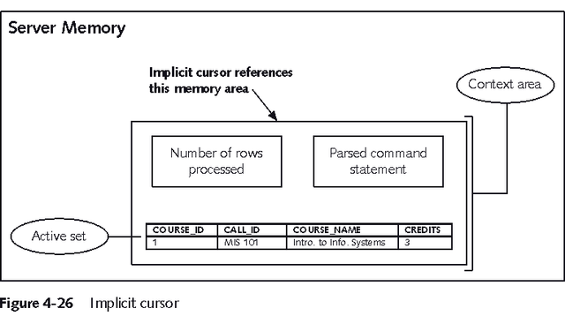
Implicit Cursor
A Guide to Oracle9i

Slide 63
Using an Implicit Cursor
Executing a SELECT query creates an implicit cursor
To retrieve it into a variable use INTO:
  SELECT field1, field2, ...
INTO variable1, variable2, ...
FROM table1, table2, ...
WHERE join_ conditions
AND search_condition_to_retrieve_1_record;
Can only be used with queries that return exactly one record
A Guide to Oracle9i

Slide 64
PL/SQL EXAMPLE
DECLARE
v_first_name VARCHAR2(35);
v_last_name VARCHAR2(35);
BEGIN
SELECT first_name, last_name
INTO v_first_name, v_last_name
FROM student
WHERE student_id = 123;
DBMS_OUTPUT.PUT_LINE
('Student name: '||v_first_name||' '||v_last_name);
EXCEPTION
WHEN NO_DATA_FOUND THEN
DBMS_OUTPUT.PUT_LINE
('There is no student with student id 123');
END;
.
/
Bordoloi and Bock

Slide 65
EXAMPLE
DECLARE
v_student_id NUMBER := &sv_student_id;
v_first_name VARCHAR2(35);
v_last_name VARCHAR2(35);
BEGIN
SELECT first_name, last_name
INTO v_first_name, v_last_name
FROM student
WHERE student_id = v_student_id;
DBMS_OUTPUT.PUT_LINE
('Student name: '||v_first_name||' '||v_last_name);
EXCEPTION
WHEN NO_DATA_FOUND THEN
DBMS_OUTPUT.PUT_LINE('There is no such student');
END;
Bordoloi and Bock

Slide 66
Explicit Cursor
Use for queries that return multiple records or no records
Must be explicitly declared and used
A Guide to Oracle9i

Slide 67
Using an Explicit Cursor
Declare the cursor
  CURSOR cursor_name IS select_query;
Open the cursor
  OPEN cursor_name;
Fetch the data rows
  LOOP
FETCH cursor_name INTO variable_name(s);
EXIT WHEN cursor_name%NOTFOUND;
Close the cursor
  CLOSE cursor_name;
A Guide to Oracle9i

Slide 68
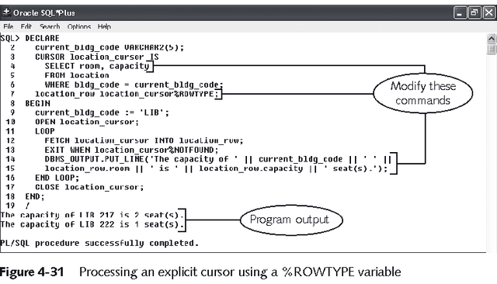
Explicit Cursor with %ROWTYPE
A Guide to Oracle9i

Slide 69
Cursor FOR Loop
Automatically opens the cursor, fetches the records, then closes the cursor
FOR variable_name(s) IN cursor_name LOOP
processing commands
END LOOP;
Cursor variables cannot be used outside loop
A Guide to Oracle9i

Slide 70
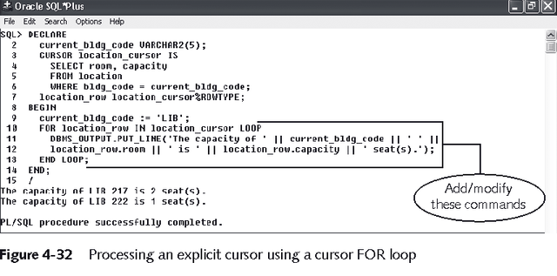
Using Cursor FOR Loop
A Guide to Oracle9i

Slide 71
Controlling Explicit Cursors
Open the cursor.
Pointer
Cursor
Fetch a row from the cursor.
Pointer
Cursor
Continue until empty.
Pointer
Cursor
Close the cursor.
Cursor
Notes:
Explicit Cursors (continued)
You use the OPEN, FETCH, and CLOSE statements to control a cursor. The OPEN statement executes the query associated with the cursor, identifies the active set, and positions the cursor (pointer) before the first row. The FETCH statement retrieves the current row and advances the cursor to the next row. When the last row has been processed, the CLOSE statement disables the cursor.

Slide 72
Declaring the Cursor
Syntax
  Do not include the INTO clause in the cursor declaration.
  If processing rows in a specific sequence is required, use the ORDER BY clause in the query.
CURSOR cursor_name IS
select_statement;
Notes:
Explicit Cursor Declaration
Use the CURSOR statement to declare an explicit cursor. You can reference variables within the query, but you must declare them before the CURSOR statement.
In the syntax:
cursor_name is a PL/SQL identifier
select_statement is a SELECT statement without an INTO clause
Note: Do not include the INTO clause in the cursor declaration because it appears later in the FETCH statement.
Class Management Note
The parameter element of the cursor definition and syntax will be covered in a subsequent lesson.

Slide 73
Opening the Cursor
Syntax
  Open the cursor to execute the query and identify the active set.
  If the query returns no rows, no exception is raised.
  Use cursor attributes to test the outcome after a fetch.
OPEN cursor_name;
Notes:
OPEN Statement
Open the cursor to execute the query and identify the active set, which consists of all rows that meet the query search criteria. The cursor now points to the first row in the active set.
In the syntax:
cursor_name is the name of the previously declared cursor
OPEN is an executable statement that performs the following operations:
1. Dynamically allocates memory for a context area that eventually contains crucial processing information.
2. Parses the SELECT statement.
3. Binds the input variables—that is, sets the value for the input variables by obtaining their memory addresses.
4. Identifies the active set—that is, the set of rows that satisfy the search criteria. Rows in the active set are not retrieved into variables when the OPEN statement is executed. Rather, the FETCH statement retrieves the rows.
5. Positions the pointer just before the first row in the active set.
Note: If the query returns no rows when the cursor is opened, PL/SQL does not raise an exception. However, you can test the status of the cursor after a fetch.
For cursors declared using the FOR UPDATE clause, the OPEN statement also locks those rows. The FOR UPDATE clause is discussed in a later lesson.

Slide 74
Fetching Data from the Cursor
Syntax
  Retrieve the current row values into output variables.
  Include the same number of variables.
  Match each variable to correspond to the columns positionally.
  Test to see if the cursor contains rows.
FETCH cursor_name INTO [variable1, variable2, ...]
| record_name];
Notes:
FETCH Statement
The FETCH statement retrieves the rows in the active set one at a time. After each fetch, the cursor advances to the next row in the active set.
In the syntax:
cursor_name is the name of the previously declared cursor
variable is an output variable to store the results
record_name is the name of the record in which the retrieved data is stored (The record variable can be declared using the %ROWTYPE attribute.)
Guidelines
Include the same number of variables in the INTO clause of the FETCH statement as output columns in the SELECT statement, and be sure that the datatypes are compatible.
Match each variable to correspond to the columns positionally.
Alternatively, define a record for the cursor and reference the record in the FETCH INTO clause.
Test to see if the cursor contains rows. If a fetch acquires no values, there are no rows left to process in the active set and no error is recorded.
Note: The FETCH statement performs the following operations:
1. Advances the pointer to the next row in the active set.
2. Reads the data for the current row into the output PL/SQL variables.
3. Exits the cursor FOR loop if the pointer is positioned at the end of the active set.

Slide 75
Explicit Cursor Attributes
Obtain status information about a cursor.
Attribute Type Description
%ISOPEN Boolean Evaluates to TRUE if the cursor is open
%NOTFOUND Boolean Evaluates to TRUE if the most recent fetch does not return a row
%FOUND Boolean Evaluates to TRUE if the most recent fetch returns a row; complement of %NOTFOUND
%ROWCOUNT Number Evaluates to the total number of rows returned so far
Notes:
Explicit Cursor Attributes
As with implicit cursors, there are four attributes for obtaining status information about a cursor. When appended to the cursor variable name, these attributes return useful information about the execution of a data manipulation statement.
Note: You cannot reference cursor attributes directly in a SQL statement.

Slide 76
Cursors and Records
Process the rows of the active set conveniently by fetching values into a PL/SQL RECORD.
Example
DECLARE
CURSOR emp_cursor IS
SELECT empno, ename
FROM emp;
emp_record emp_cursor%ROWTYPE;
BEGIN
OPEN emp_cursor;
LOOP
FETCH emp_cursor INTO emp_record;
...
Notes:
Cursors and Records
You have already seen that you can define records to use the structure of columns in a table. You can also define a record based on the selected list of columns in an explicit cursor. This is convenient for processing the rows of the active set, because you can simply fetch into the record. Therefore, the values of the row are loaded directly into the corresponding fields of the record.
Example: Use a cursor to retrieve employee numbers and names and populate a temporary database table with this information.
DECLARE
CURSOR emp_cursor IS
SELECT empno, ename
FROM emp;
emp_record emp_cursor%ROWTYPE;
BEGIN
OPEN emp_cursor;
LOOP
FETCH emp_cursor INTO emp_record;
EXIT WHEN emp_cursor%NOTFOUND;
INSERT INTO temp_list (empid, empname)
VALUES (emp_record.empno, emp_record.ename);
END LOOP;
COMMIT;
CLOSE emp_cursor;
END ;

Slide 77
Cursor FOR Loops
Syntax
  The cursor FOR loop is a shortcut to process explicit cursors.
  Implicit open, fetch, and close occur.
  The record is implicitly declared.
FOR record_name IN cursor_name LOOP
statement1;
statement2;
. . .
END LOOP;
Notes:
Cursor FOR Loops
A cursor FOR loop processes rows in an explicit cursor. It is a shortcut because the cursor is opened, rows are fetched once for each iteration in the loop, and the cursor is closed automatically when all rows have been processed. The loop itself is terminated automatically at the end of the iteration where the last row was fetched.
In the syntax:
record_name is the name of the implicitly declared record
cursor_name is a PL/SQL identifier for the previously declared cursor
Guidelines
Do not declare the record that controls the loop. Its scope is only in the loop.
Test the cursor attributes during the loop, if required.
Supply the parameters for a cursor, if required, in parentheses following the cursor name in the FOR statement. More information on cursor parameters is covered in a subsequent lesson.
Do not use a cursor FOR loop when the cursor operations must be handled manually.
Note: You can define a query at the start of the loop itself. The query expression is called a SELECT substatement, and the cursor is internal to the FOR loop. Because the cursor is not declared with a name, you cannot test its attributes.

Slide 78
Cursor FOR Loops
Using Subqueries
No need to declare the cursor.
Example
BEGIN
FOR emp_record IN ( SELECT ename, deptno
FROM emp) LOOP
-- implicit open and implicit fetch occur
IF emp_record.deptno = 30 THEN
...
END LOOP; -- implicit close occurs
END;
Notes:
Cursor FOR Loops Using Subqueries
You do not need to declare a cursor because PL/SQL lets you substitute a subquery. This example does the same thing as the one on the previous page. It is complete code for the slide above.
Class Management Note
This syntax simplifies the coding of cursors, but you cannot define a cursor with parameters.
SET SERVEROUTPUT ON
BEGIN
FOR emp_record IN (SELECT ename, deptno
FROM emp) LOOP
--implicit open and implicit fetch occur
IF emp_record.deptno = 30 THEN
DBMS_OUTPUT.PUT_LINE ('Employee ' || emp_record.ename
|| ' works in the Sales Dept. ');
END IF;
END LOOP; --implicit close occurs
END ;
/

Slide 79
Cursors with Parameters
Syntax
  Pass parameter values to a cursor when the cursor is opened and the query is executed.
  Open an explicit cursor several times with a different active set each time.
CURSOR cursor_name
[(parameter_name datatype, ...)]
IS
select_statement;
Notes:
Cursors with Parameters
Parameters allow values to be passed to a cursor when it is opened and to be used in the query when it executes. This means that you can open and close an explicit cursor several times in a block, returning a different active set on each occasion.
Each formal parameter in the cursor declaration must have a corresponding actual parameter in the OPEN statement. Parameter datatypes are the same as those for scalar variables, but you do not give them sizes. The parameter names are for references in the query expression of the cursor.
In the syntax:
cursor_name is a PL/SQL identifier for the previously declared cursor
parameter_name is the name of a parameter (Parameter stands for the following syntax.)
datatype is a scalar datatype of the parameter
select_statement is a SELECT statement without the INTO clause
When the cursor is opened, you pass values to each of the parameters positionally. You can pass values from PL/SQL or host variables as well as from literals.
Note: The parameter notation does not offer greater functionality; it simply allows you to specify input values easily and clearly. This is particularly useful when the same cursor is referenced repeatedly.
cursor_parameter_name [IN] datatype [{:= | DEFAULT} expr]

Slide 80
Cursors with Parameters
Pass the department number and job title to the WHERE clause.
Example
DECLARE
CURSOR emp_cursor
(v_deptno NUMBER, v_job VARCHAR2) IS
SELECT empno, ename
FROM emp
WHERE deptno = v_deptno
AND job = v_job;
BEGIN
OPEN emp_cursor(10, 'CLERK');
...
Notes:
Parameter datatypes are the same as those for scalar variables, but you do not give them sizes. The parameter names are for references in the cursor’s query.
In the following example, two variables and a cursor are declared. The cursor is defined with two parameters.
Either of the following statements opens the cursor:
You can pass parameters to the cursor used in a cursor FOR loop:
DECLARE
v_emp_job emp.job%TYPE := 'CLERK';
v_ename emp.ename%TYPE;
CURSOR emp_cursor(v_deptno NUMBER, v_job VARCHAR2) is
SELECT ...
OPEN emp_cursor(10, v_emp_job);
OPEN emp_cursor(20, 'ANALYST');
DECLARE
CURSOR emp_cursor(v_deptno NUMBER, v_job VARCHAR2) is
SELECT ...
BEGIN
FOR emp_record IN emp_cursor(10, 'ANALYST') LOOP ...

Slide 81
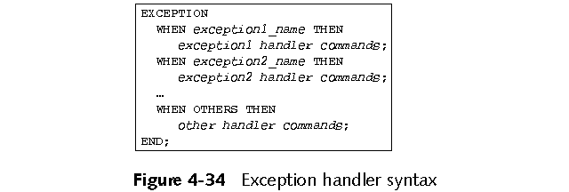
Handling Runtime Errors in PL/SQL Programs
Runtime errors cause exceptions
Exception handlers exist to deal with different error situations
Exceptions cause program control to fall to exception section where exception is handled
A Guide to Oracle9i

Slide 82
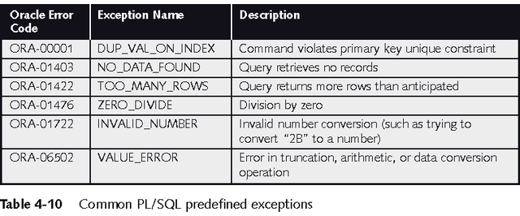
Predefined Exceptions
A Guide to Oracle9i

Slide 83
Undefined Exceptions
Less common errors
Do not have predefined names
Must declare your own name for the exception code in the declaration section
  DECLARE
e_exception_name EXCEPTION;
PRAGMA EXCEPTION_INIT(e_exception_name,
-Oracle_error_code);
A Guide to Oracle9i

Slide 84
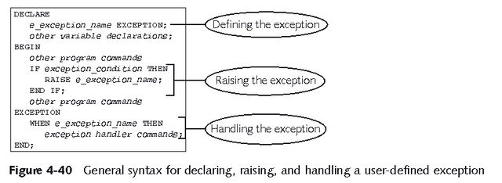
User-Defined Exceptions
Not a real Oracle error
Use to enforce business rules
A Guide to Oracle9i

Slide 85
Handling Exceptions with PL/SQL
  What is an exception?
    Identifier in PL/SQL that is raised during execution
  How is it raised?
    An Oracle error occurs.
    You raise it explicitly.
  How do you handle it?
    Trap it with a handler.
    Propagate it to the calling environment.
Notes:
Overview
An exception is an identifier in PL/SQL, raised during the execution of a block that terminates its main body of actions. A block always terminates when PL/SQL raises an exception, but you specify an exception handler to perform final actions.
Two Methods for Raising an Exception
An Oracle error occurs and the associated exception is raised automatically. For example, if the error ORA-01403 occurs when no rows are retrieved from the database in a SELECT statement, then PL/SQL raises the exception NO_DATA_FOUND.
You raise an exception explicitly by issuing the RAISE statement within the block. The exception being raised may be either user defined or predefined.

Slide 86
Handling Exceptions
Trap the exception
Propagate the exception
DECLARE
DECLARE
BEGIN
BEGIN
Exception
is raised
Exception
is raised
EXCEPTION
EXCEPTION
Exception
is trapped
Exception is
not trapped
END;
END;
Exception propagates to calling environment
Notes:
Trapping an Exception
If the exception is raised in the executable section of the block, processing branches to the corresponding exception handler in the exception section of the block. If PL/SQL successfully handles the exception, then the exception does not propagate to the enclosing block or environment. The PL/SQL block terminates successfully.
Propagating an Exception
If the exception is raised in the executable section of the block and there is no corresponding exception handler, the PL/SQL block terminates with failure and the exception is propagated to the calling environment.

Slide 87
Exception Types
}
  Predefined Oracle Server
  Non-predefined Oracle Server
  User-defined
Implicitly
raised
Explicitly raised
Notes:
Exception Types
You can program for exceptions to avoid disruption at runtime. There are three types of exceptions.
Note: Some application tools with client-side PL/SQL, such as Oracle Developer Forms, have their own exceptions.

Slide 88
Trapping Exceptions
Syntax
EXCEPTION
WHEN exception1 [OR exception2 . . .] THEN
statement1;
statement2;
. . .
[WHEN exception3 [OR exception4 . . .] THEN
statement1;
statement2;
. . .]
[WHEN OTHERS THEN
statement1;
statement2;
. . .]
Notes:
Trapping Exceptions
You can trap any error by including a corresponding routine within the exception handling section of the PL/SQL block. Each handler consists of a WHEN clause, which specifies an exception, followed by a sequence of statements to be executed when that exception is raised.
In the syntax:
WHEN OTHERS Exception Handler
The exception-handling section traps only those exceptions specified; any other exceptions are not trapped unless you use the OTHERS exception handler. This traps any exception not yet handled. For this reason, OTHERS is the last exception handler defined.
The OTHERS handler traps all exceptions not already trapped. Some Oracle tools have their own predefined exceptions that you can raise to cause events in the application. OTHERS also traps these exceptions.

Slide 89
Trapping Predefined
Oracle Server Errors
  Reference the standard name in the exception-handling routine.
  Sample predefined exceptions:
    NO_DATA_FOUND
    TOO_MANY_ROWS
    INVALID_CURSOR
    ZERO_DIVIDE
    DUP_VAL_ON_INDEX
Notes:
Trapping Predefined Oracle Server Errors
Trap a predefined Oracle Server error by referencing its standard name within the corresponding exception-handling routine.
For a complete list of predefined exceptions, see
PL/SQL User’s Guide and Reference, Release 8, “Error Handling.”
Note: PL/SQL declares predefined exceptions in the STANDARD package.
It is a good idea to always consider the NO_DATA_FOUND and TOO_MANY_ROWS exceptions, which are the most common.

Slide 90
Predefined Exception
Syntax
BEGIN SELECT ... COMMIT;
EXCEPTION
WHEN NO_DATA_FOUND THEN
statement1;
statement2;
WHEN TOO_MANY_ROWS THEN
statement1;
WHEN OTHERS THEN
statement1;
statement2;
statement3;
END;
Notes:
Trapping Predefined Oracle Server Exceptions
Only one exception is raised and handled at any time.

Slide 91
Trapping Non-Predefined Oracle Server Errors
Declare
Associate
Reference
Declarative section
Exception-handling
section
Name the exception
Code the PRAGMA EXCEPTION_INIT
Handle the raised exception
Notes:
Trapping Non-Predefined Oracle Server Errors
You trap a non-predefined Oracle Server error by declaring it first, or by using the OTHERS handler. The declared exception is raised implicitly. In PL/SQL, the pragma EXCEPTION_INIT tells the compiler to associate an exception name with an Oracle error number. That allows you to refer to any internal exception by name and to write a specific handler for it.
Note: PRAGMA (also called pseudoinstructions) is the keyword that signifies that the statement is a compiler directive, which is not processed when the PL/SQL block is executed. Rather, it directs the PL/SQL compiler to interpret all occurrences of the exception name within the block as the associated Oracle Server error number.

Slide 92
Non-Predefined Error
Trap for Oracle Server error number
–2292, an integrity constraint violation.
DECLARE
e_emps_remaining EXCEPTION;
PRAGMA EXCEPTION_INIT (
e_emps_remaining, -2292);
v_deptno dept.deptno%TYPE := &p_deptno;
BEGIN
DELETE FROM dept
WHERE deptno = v_deptno;
COMMIT;
EXCEPTION
WHEN e_emps_remaining THEN
DBMS_OUTPUT.PUT_LINE ('Cannot remove dept ' ||
TO_CHAR(v_deptno) || '. Employees exist. ');
END;
1
2
3
Notes:
Trapping a Non-Predefined Oracle Server Exception
1. Declare the name for the exception within the declarative section.
Syntax
where: exception is the name of the exception.
2. Associate the declared exception with the standard Oracle Server error number using the PRAGMA EXCEPTION_INIT statement.
Syntax
where: exception is the previously declared exception.
error_number is a standard Oracle Server error number.
3. Reference the declared exception within the corresponding exception-handling routine.
Example
If there are employees in a department, print a message to the user that the department cannot be removed.
For more information, see
Oracle Server Messages, Release 8.
exception EXCEPTION;
PRAGMA EXCEPTION_INIT(exception, error_number);

Slide 93
Trapping User-Defined Exceptions
Declare
Raise
Reference
Declarative
section
Executable
section
Exception-handling
section
Name the exception
Explicitly raise the exception by using the RAISE statement
Handle the raised exception
Notes:
Trapping User-Defined Exceptions
PL/SQL lets you define your own exceptions. User-defined PL/SQL exceptions must be:
Declared in the declare section of a PL/SQL block
Raised explicitly with RAISE statements

Slide 94
User-Defined Exception
Example
DECLARE
e_invalid_product EXCEPTION;
BEGIN
UPDATE product
SET descrip = '&product_description'
WHERE prodid = &product_number;
IF SQL%NOTFOUND THEN
RAISE e_invalid_product;
END IF;
COMMIT;
EXCEPTION
WHEN e_invalid_product THEN
DBMS_OUTPUT.PUT_LINE('Invalid product number.');
END;
1
2
3
Notes:
Trapping User-Defined Exceptions (continued)
You trap a user-defined exception by declaring it and raising it explicitly.
1. Declare the name for the user-defined exception within the declarative section.
Syntax
where: exception is the name of the exception
2. Use the RAISE statement to raise the exception explicitly within the executable section.
Syntax
where: exception is the previously declared exception
3. Reference the declared exception within the corresponding exception handling routine.
Example
This block updates the description of a product. The user supplies the product number and the new description. If the user enters a product number that does not exist, no rows will be updated in the PRODUCT table. Raise an exception and print a message to the user alerting them that an invalid product number was entered.
Note: Use the RAISE statement by itself within an exception handler to raise the same exception back to the calling environment.
exception EXCEPTION;
RAISE exception;

Slide 95
Summary
PL/SQL is a programming language for working with an Oracle database
Scalar, composite and reference variables can be used
The IF/THEN/ELSE decision control structure allows branching logic
Five loop constructs allow repeating code
Cursors are returned from queries and can be explicitly iterated over
Exception handling is performed in the exception section. User defined exceptions help to enforce business logic
A Guide to Oracle9i

